Slide 1
Coursera Capstone IBM Applied Data Science Capstone
RECOMENDATION SYSTEM FOR OPENING A NEW RESTAURANT IN KUALA LUMPUR, MALAYSIA
bY: teguh badrusalam

Slide 2
Business Problem
Location of the restaurant is one of the most important decisions that will determine whether the mall will be a success of a failure
Objective : To analyse and select the bst location in the cyty of Kuala Lumpur, Malaysia to open a new restaurant
This project is timely as the city is currently suffering from oversupply of restaurant.
Business question
In the city of Kuala Lumpur, Malaysia, if a property developer is looking to open a new shopping mall, where would you recommend that they open it?

Slide 3
Data
Data Required
List of neighborhoods in Kuala Lumpur
Latitude and Longitude coordinates of the neighborhoods
Venue data, particulary data related to restaurant
Source of Data
Wikipedia page for neighborhoods (https://en.wikipedia.org/wiki/category:suburbs_in_kuala_lumpur)
Geocoder package for Latitude and Longitude coordinates
Forsquare API venue for venue data

Slide 4
Methodology
Web scrapping wikipedia page for neighborhoods list
Get latitude and longitude coordinates using geocoder
Use forsquare API to get venue data
Group data by neighborhood and taking the mean of the frequency of occurance of each venue category
Filter venue category by restaurant
Perform clustering on the data by using k-means clustering
Visualize the clusters in a map using Folium

Slide 5
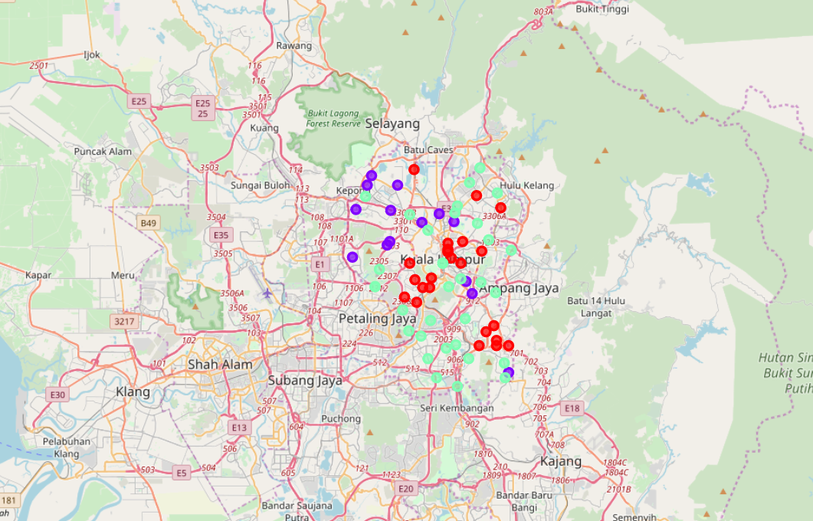
Results
Categorized the neighborhoos into 3 clusters:
Cluster 0 : Neighborhoods with moderate number of restaurant
Cluster 1 : Neighborhoods with low number to no existance of restaurant
Cluster 2 : Neighborhoods with high concentrantion of restaurant

Slide 6
Discussion
Most of the restaurant are concerted in the central area of the city
Highest number in cluster 2 and moderate number in cluster 0
Cluster 1 has very low number to no restaurant in the neighborhoods
Oversuplay of restaruant mostly happed in the central area of the city, with the subrub area stil have very few restaurant

Slide 7
Conclusion
Answer to business question: The neighborhoods in cluster 1 are the most prefered locations to open a new restaurant
Findings of this project will help the relevant stakeholders to capitalize on the opportunities on high potential locations while avoiding overcrowded areas in their decisions to open a new restaurant

